Slide 1






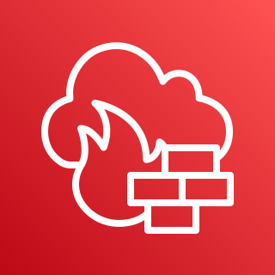

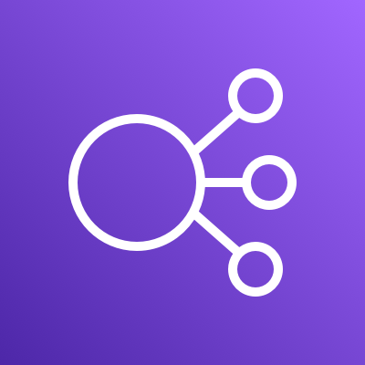














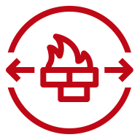










AWS Cloud
Region - Oregon
VPC – vpc
10.0.0.0/20
Availability Zone 1
Public subnet
10.0.0.0/24
Public-Edge
Private subnet
10.0.14.0/24 – RDS2
Corporate
data center
Security group
Security group
Availability Zone 2
Private subnet
10.0.4.0/22 – WEB
Private subnet
10.0.8.0/22 – API
Private subnet
10.0.12.0/24 – Read DB
Private subnet
10.0.13.0/24 – RDS1
Generic group
Security group
Auto Scaling group
Security group
Security group
Auto Scaling group
Security group

Slide 2
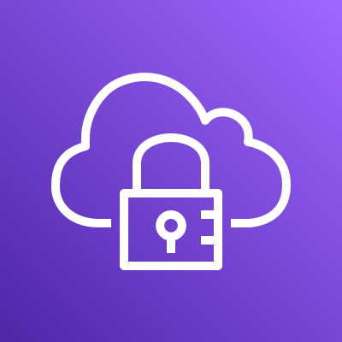
아이콘 모음
Elastic Load Balancing
AWS Client VPN

